Slide 1



TUNE NEST
IET CDAC PUNE
Presented By:
Jayashree Derkar (250245920035)
Likesh Chaudhari (250245920048)
Chetan Thorat (250245920020)
Krishna Pandit (250245920060)
Web Music Player
1

Slide 2

OUR AIM:
"To develop a full-stack web-based music player application that allows users to stream, upload, and manage songs, create personalized playlists, interact through comments and ratings, and receive music recommendations with secure authentication and a user-friendly interface”
2

Slide 3

Content:
Project Overview
Problem Statement
Goals and Objectives
Proposed Solution
Key Modules
System Architecture with UML Diagrams
Software Requirement Specifications
Scope and Conclusion
3

Slide 4




Project Overview:
This project is a full-stack music player web application designed to offer users a smooth music streaming experience similar to platforms like Spotify, Apple Music etc.
The application allows users to:
Create, edit, and manage playlists based on their preferences.
Rate and comment on songs to engage with other users.
Track playback history and receive personalized music recommendations.
Switch between dark and light themes for a better visual experience.
4

Slide 5
Project Overview:
The system also includes an admin panel where administrators can manage users, songs, and view usage statistics.
The application uses React for the frontend, .NET for the backend, and MongoDB as the database, with deployment planned on AWS for scalability and performance.
5

Slide 6
Problem Statement:
Most music platforms are complex and not beginner-friendly.
Users cannot easily upload and manage their own songs.
Personalized recommendations are often limited or inaccurate.
Platforms are overloaded with ads and distractions.
User interaction features like comments and ratings are missing.
6

Slide 7
Goal and Objective:
Develop a user-friendly web platform for music streaming.
Allow users to upload, play, and manage their songs.
Enable users to upload and play their own songs.
Allow creation and management of custom playlists.
Provide personalized music recommendations.
Add interactive features like song ratings and comments.
7

Slide 8
Proposed Solution:
Develop a full-stack web application for music streaming.
Use React for a clean, responsive, and interactive frontend.
Implement a secure .NET backend with JWT-based authentication.
Allow users to upload, stream, and manage their songs.
Enable playlist creation, ratings, and commenting on songs.
Include a recommendation engine based on user behavior.
Store user data and music metadata in MongoDB.
Deploy the application on AWS for scalability and high availability.
8

Slide 9
Key Modules:
Role-based access control (User/Admin)
Upload, stream, edit, and delete songs
Store song metadata (title, artist, album, genre)
Create, update, delete playlists
Add or remove songs from playlists
Suggest songs based on user history and preferences
Enhance personalization using listening data
Users can comment on songs
Rate songs and view average ratings
Track songs played by user
Use history to improve recommendations
Admins can manage users and songs
9

Slide 10
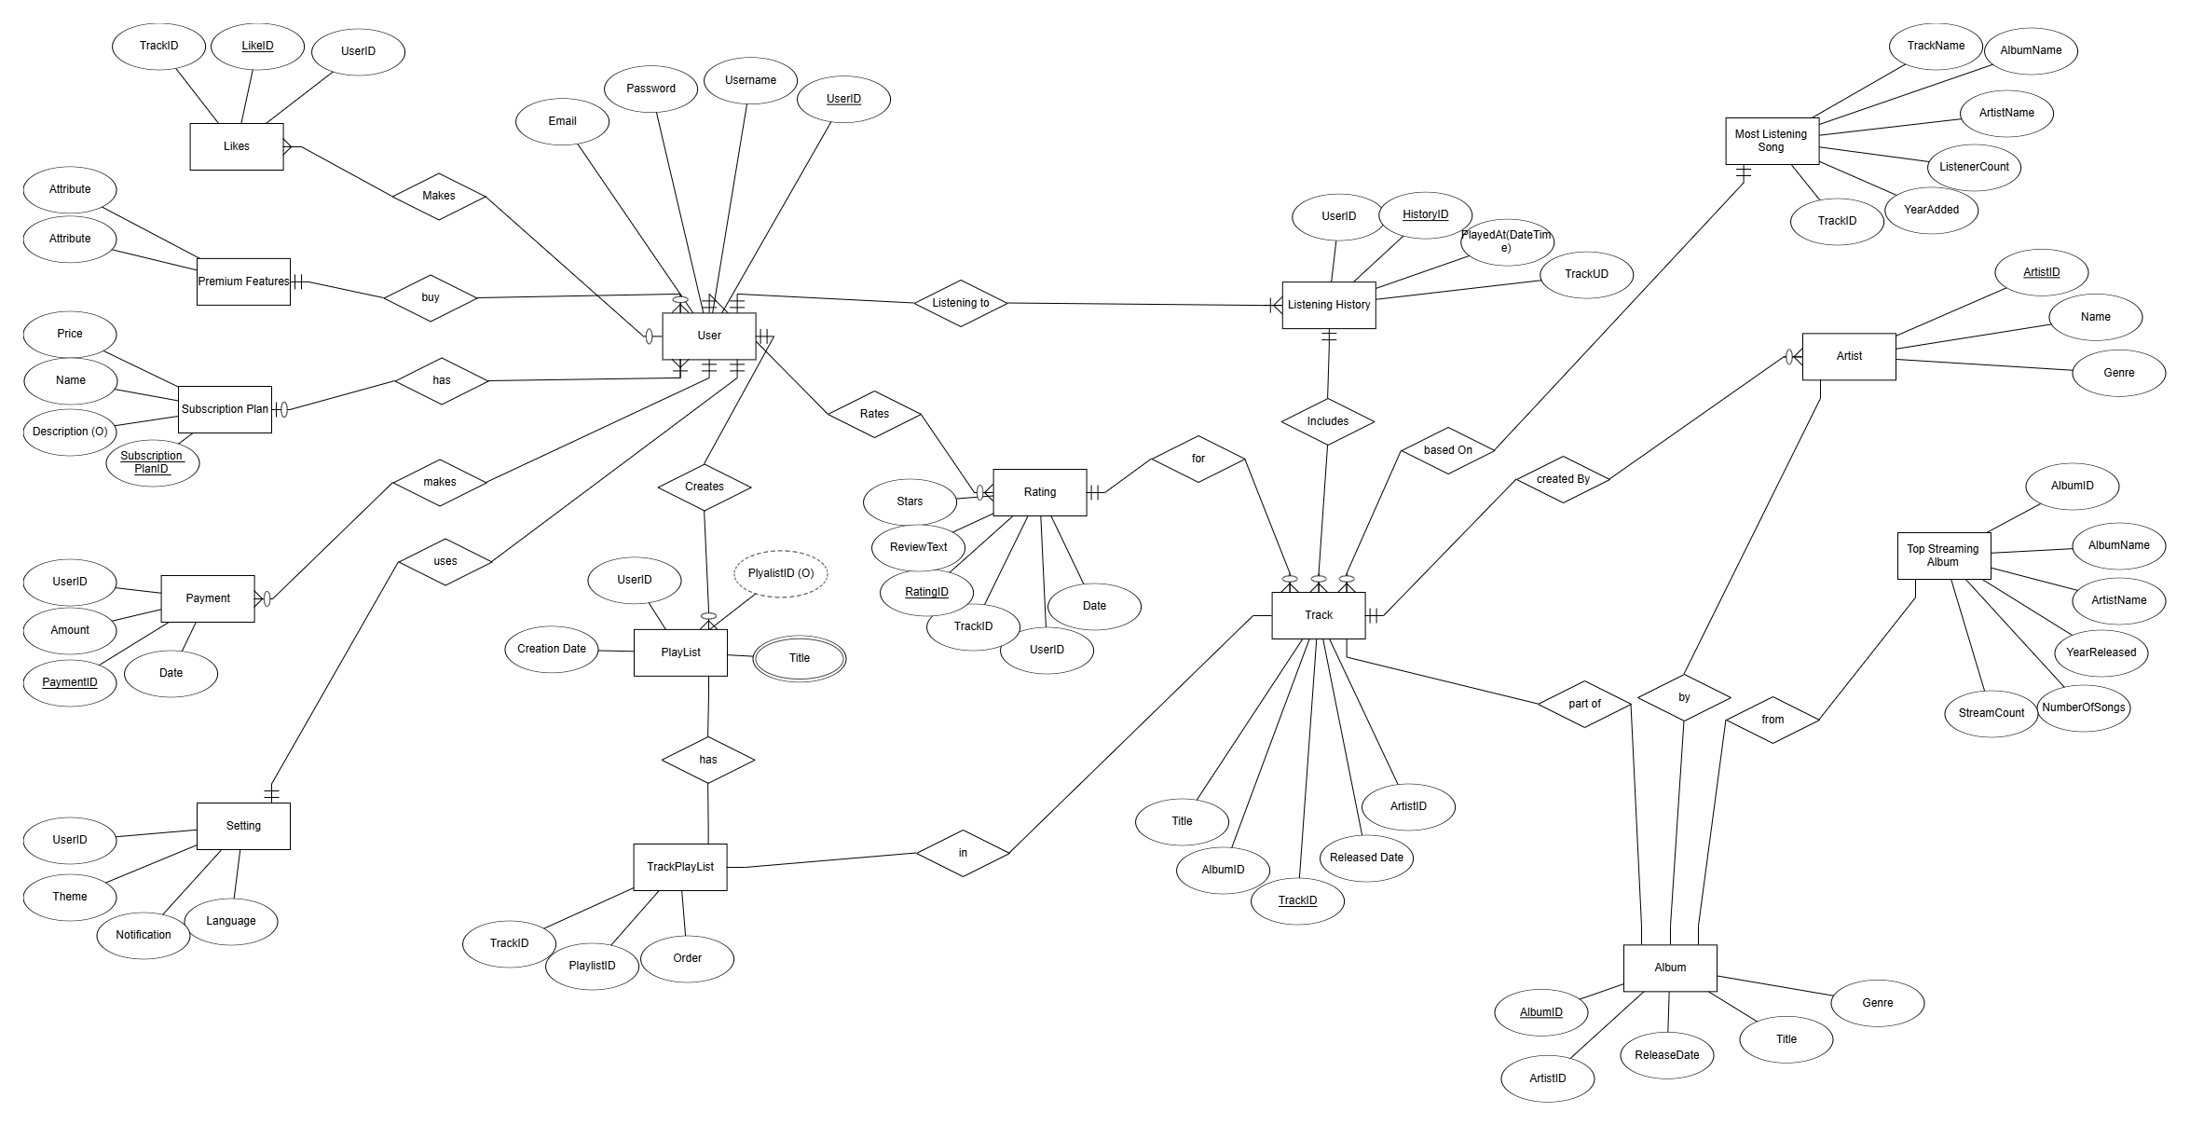
UML Diagrams
Entity Relationship Diagram
10

Slide 11
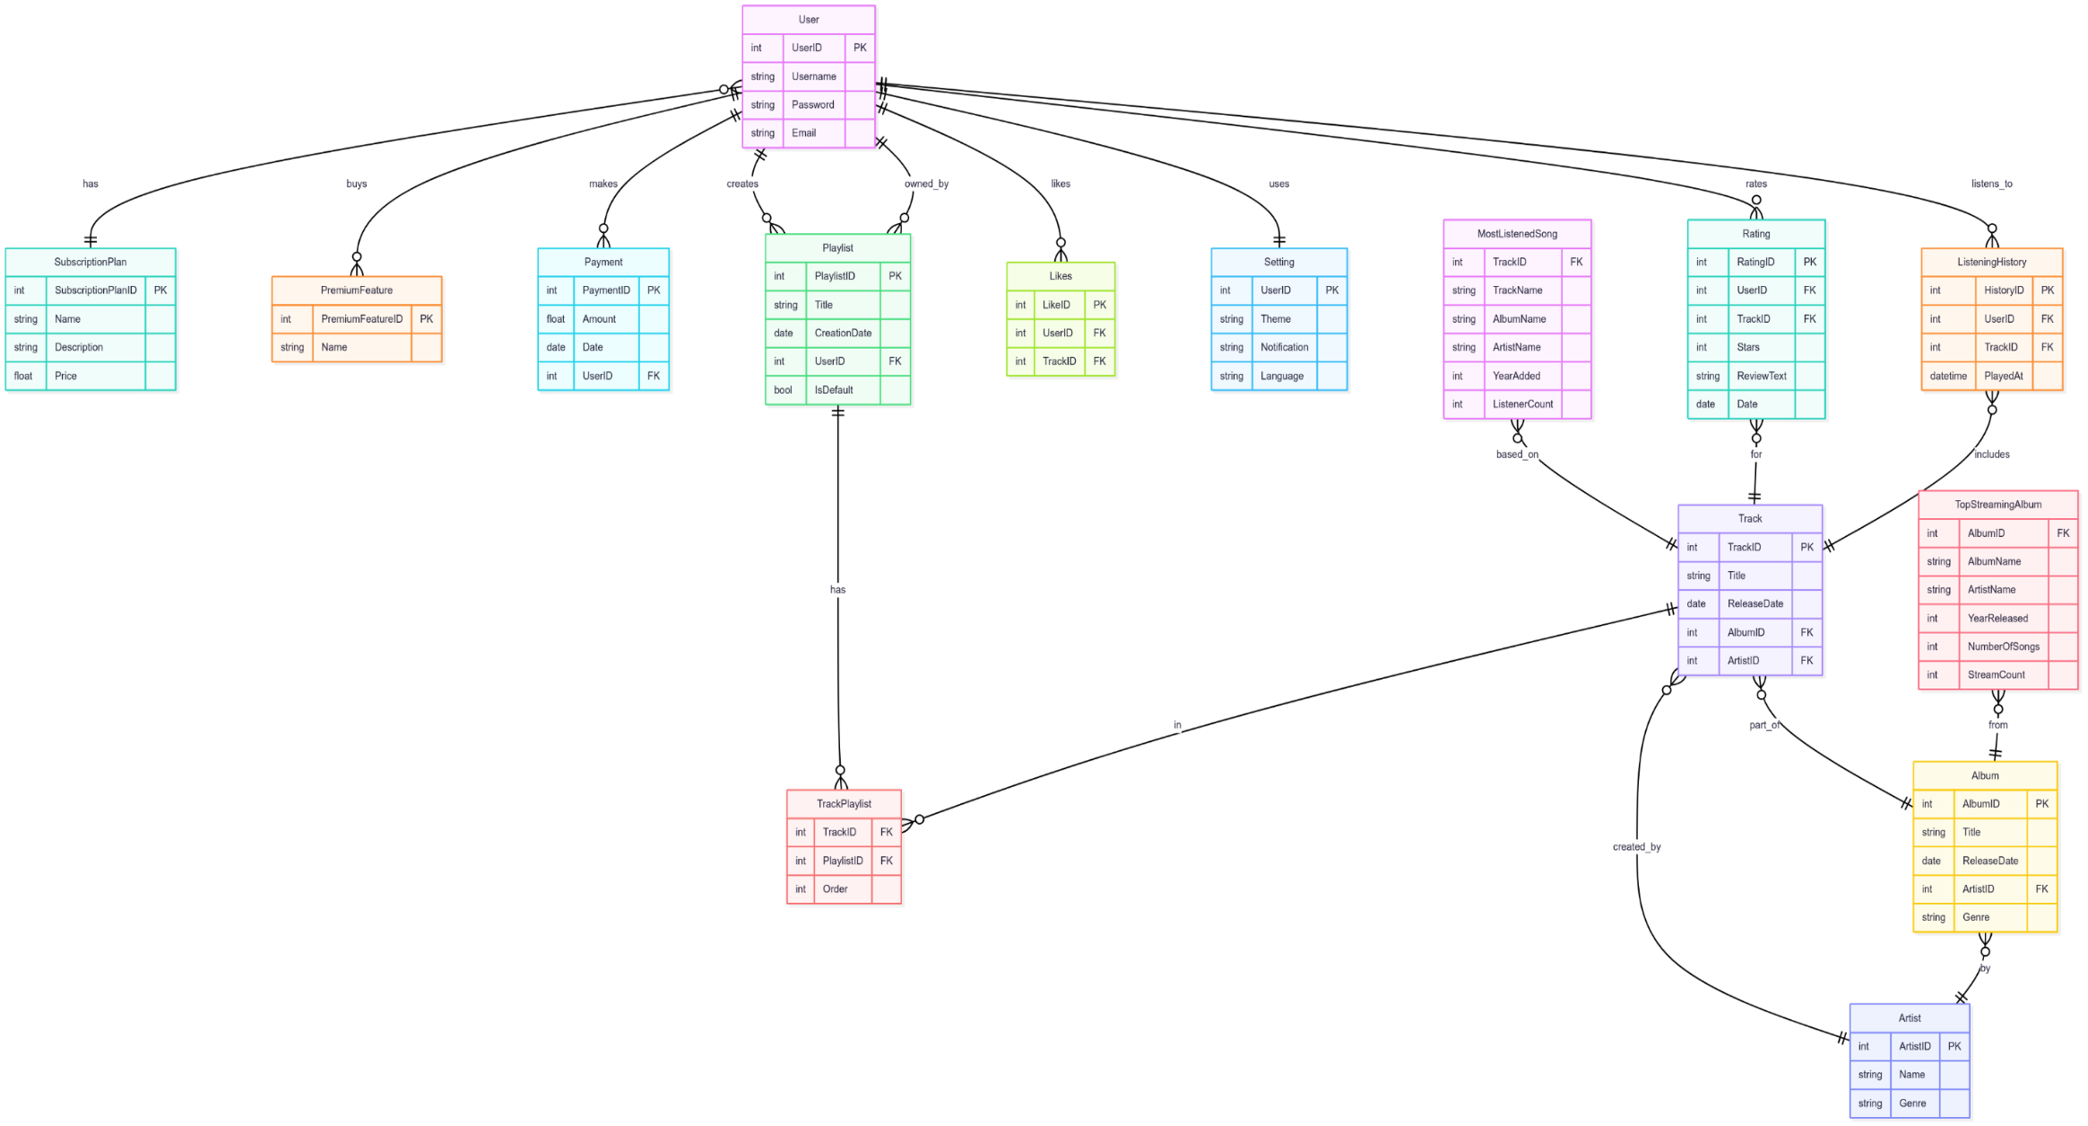
UML Diagrams
Entity Relationship Diagram
11

Slide 12
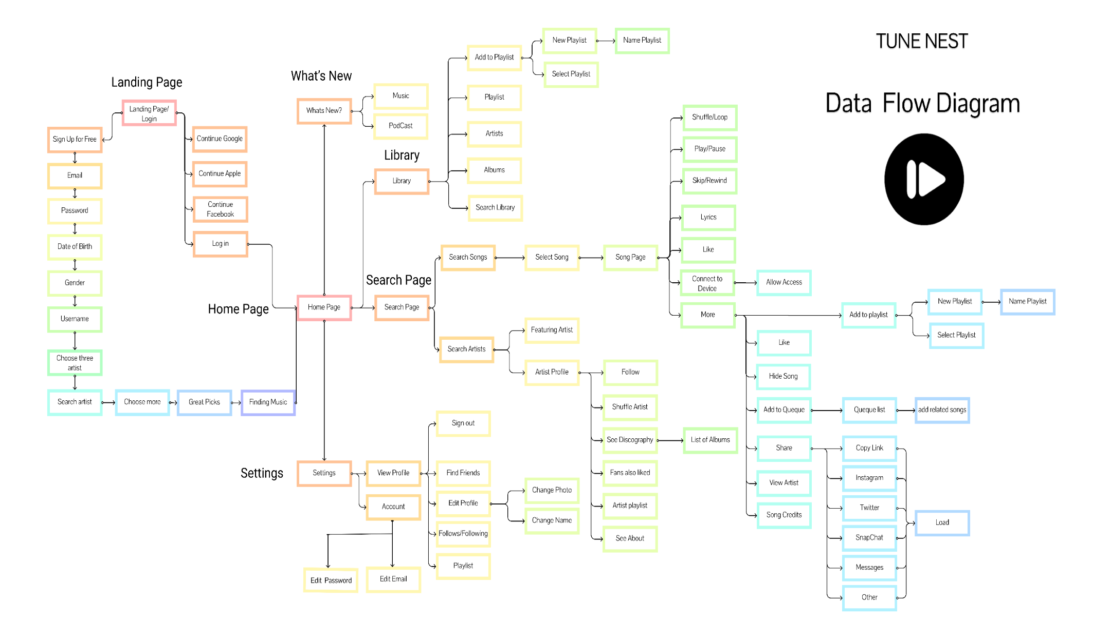
UML Diagrams
Data Flow Diagram
12

Slide 13
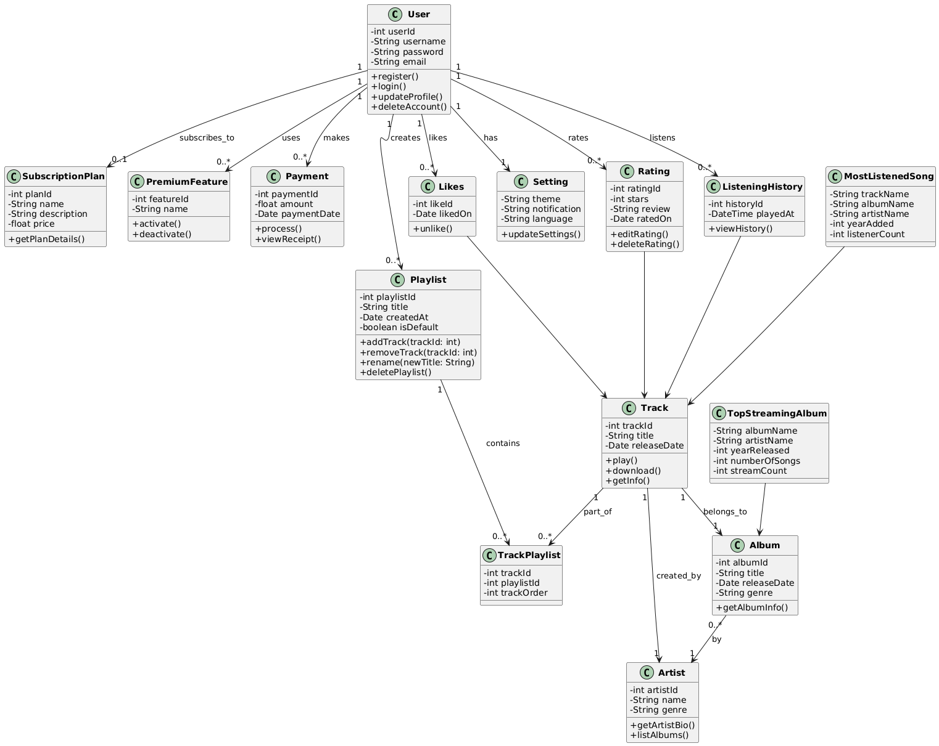
UML Diagrams
Class Diagram
13

Slide 14
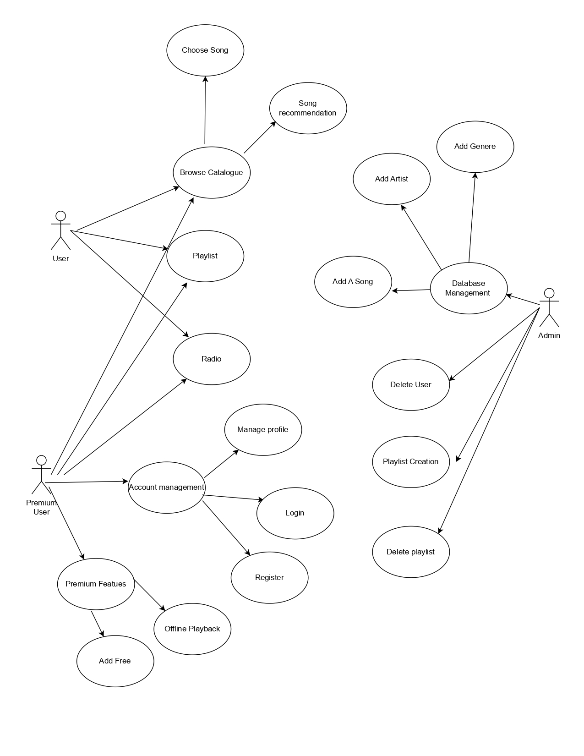
UML Diagrams
Use Case Diagram
14

Slide 15
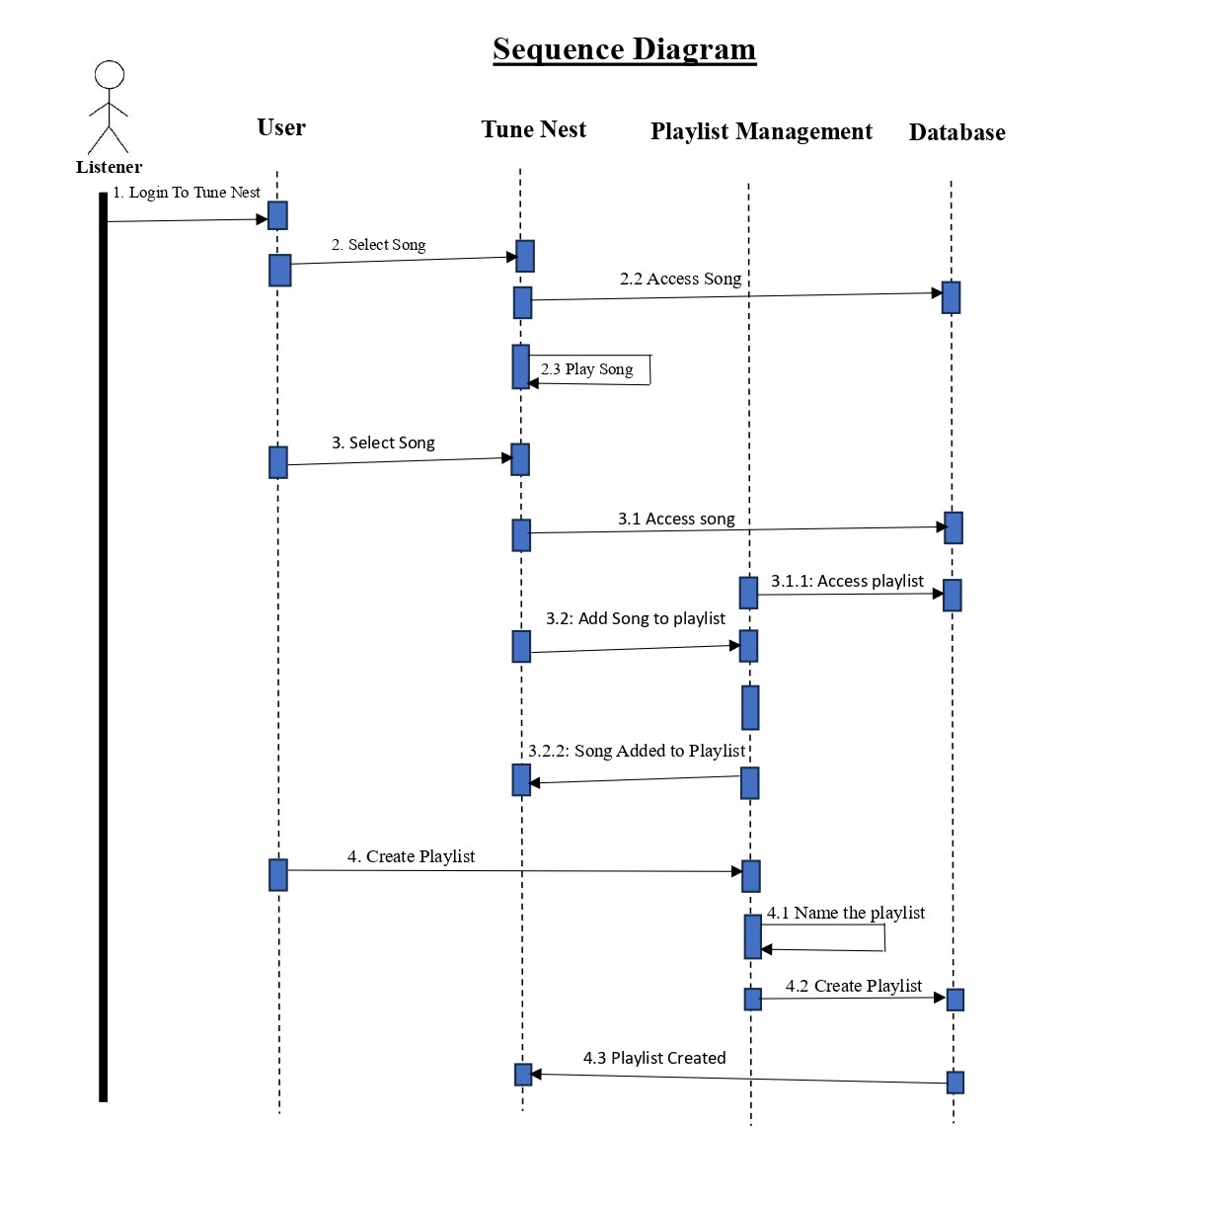
UML Diagrams
Sequence Diagram
15

Slide 16
Software Requirement Specifications:
To build a secure, user-friendly platform for uploading, streaming, and managing music.
Key Features:
User registration & login
Song upload & playback
Playlist creation
Comments & ratings
Recommendations
Admin dashboard
Deployment: Cloud-based (AWS)
Technology Stack of Project
16

Slide 17
Scope and Conclusion:
Provides a full-stack web platform for music streaming and management.
Allows users to register, upload songs, create playlists, and interact with music.
Includes personalized recommendations based on listening history.
Offers secure JWT-based login and role-based admin control.
Designed to be responsive, scalable, and user-friendly across all devices.
Helps overcome limitations of existing platforms like ads, lack of customization, and limited interaction.
Built using modern technologies like React, .NET, MongoDB, and AWS.
Adding of a music/song recognition system.
Aims to deliver a complete, smooth, and engaging music streaming experience for all users.
17

Slide 18
Thankyou
18

